Slide 1

Artificial Intelligence
Lecture 07 – Markov Decision Process
Dr. Rajiv Misra, Professor
Dept. of Computer Science & Engg.
Indian Institute of Technology, Patna
rajivm@iitp.ac.in

Slide 2
Decisions - Decision Theory
Decision Analysis (Present all possibilities)
Decision Making (Choose the best one)

Slide 3
Utility Functions and Value of Information
Is paying more for a product a proxy for utility?
if someone in the street stops you and offers:
  1. 100% chance of $300K or 80% chance of $400K.
  2. 25% chance of $300K or 20% chance of $400K
Value of Information vs. Likelihood (test for Cancer w/small chance you may have it)

Slide 4
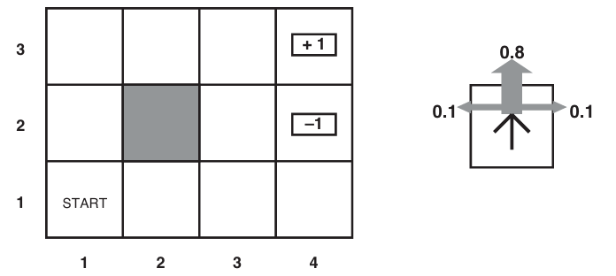
Scenario
Robot Game: A sequential decision problem
A simple 4×3 environment that presents the agent with a sequential decision problem.
Transition model of the environment: the “intended” outcome occurs with probability 0.8, but with probability 0.2 the agent moves at right angles to the intended direction.
A collision with a wall results in no movement.
The two terminal states have reward +1 and–1, respectively, and all other states have a reward of–0.04.

Slide 5
Markov Decision Processes(MDP)
The Robot (Agent) wants to leave the Grid.
Each cell is a state it can be in
At each state it can follow an action
For each state and action there is a transition model P(s‘ l s, a)
For each state and action there is a reward function R(s, a, s’) or R(s)

Slide 6

Markov Decision Processes(MDP)
What does the solution look like?
Specify what the agent should do in any state – the policy
It wants to find the optimal policy $π^{∗}$ measured by the highest expected utility

Slide 7
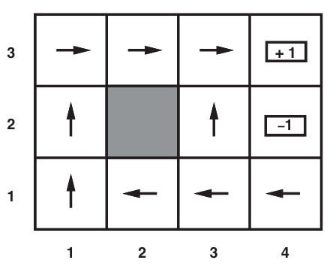

Optimal Policies
Given $π^{∗}$
Agent determines that it is in state $s$
Agent takes the action given by $π^{∗}\left(s\right)$
For example: if R(s) = -0.04 for all states

Slide 8
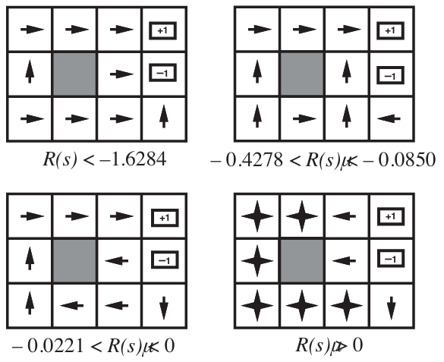
Optimal Policies
A balancing act b/w risk and reward

Slide 9
Utilities – over time
If you have a finite number of steps, your optimal policy changes.
What would be the optimal policy if you had 3 steps in total?
What if you had 2340 steps?

Slide 10
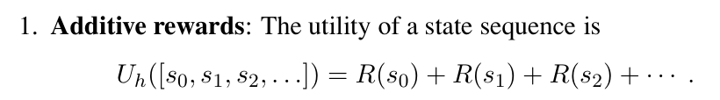
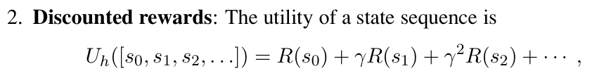
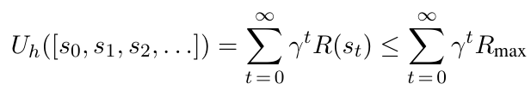
Utilities - Discounted Rewards
..

Slide 11
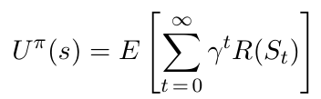


Policies and Utilities
The expected utility obtained by executing policy $π$ starting in state s is
And the optimal policy for state s is:

Slide 12
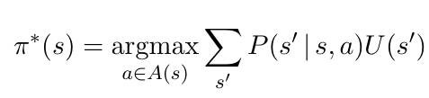
Optimal Policy – In other words
The optimal policy can be computed as:
with A(s) being all possible actions from state s

Slide 13
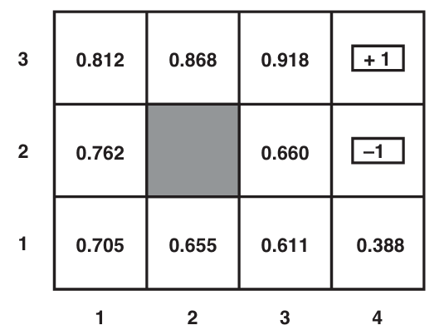

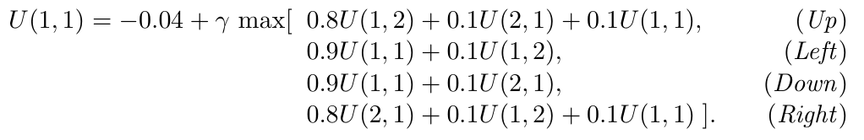
Expected Utility – Bellman Equation
..

Slide 14
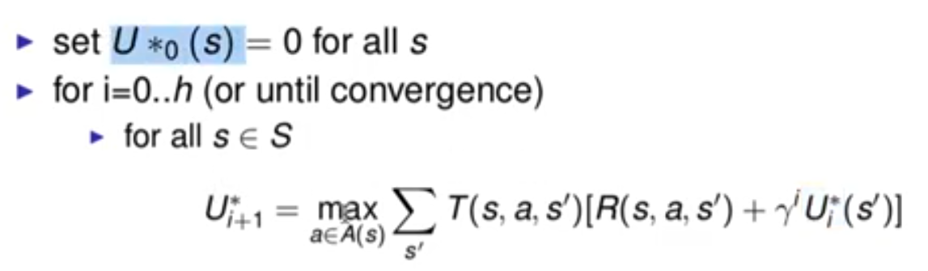
Value Iteration
Idea: Start with arbitrary utility values
Update to make them locally consistence with Bellman Equation
Everywhere locally consistent => global optimality

Slide 15
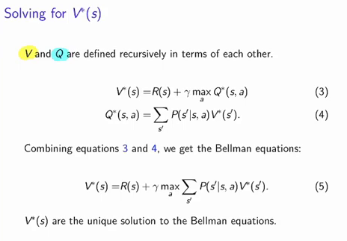
Value Iteration

Slide 16
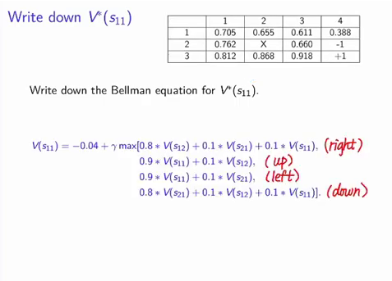
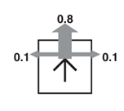
Value Iteration

Slide 17
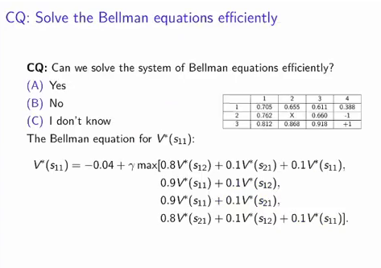
Value Iteration

Slide 18
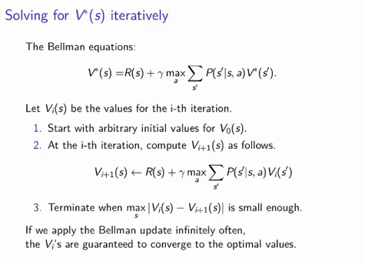
..
Value Iteration

Slide 19
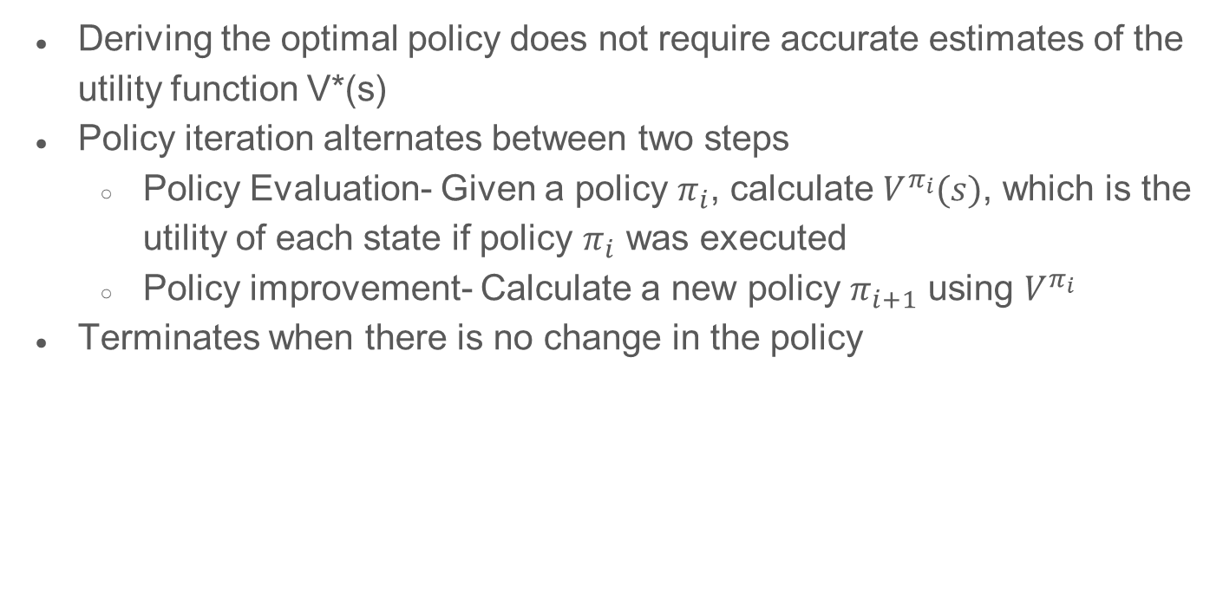
..
Policy Iteration
Deriving the optimal policy does not require accurate estimates of the utility function V*(s)
Policy iteration alternates between two steps
  Policy Evaluation- Given a policy $π_{i}$, calculate $V^{π_{i}}(s)$, which is the utility of each state if policy $π_{i}$ was executed
  Policy improvement- Calculate a new policy $π_{i+1}$ using $V^{π_{i}}$
Terminates when there is no change in the policy

Slide 20
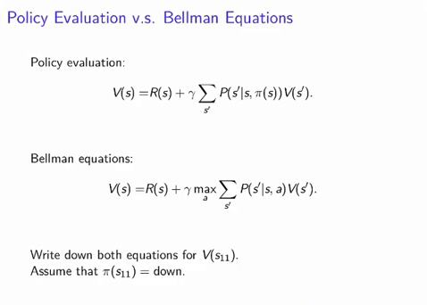
Policy Iteration v/s Bellman Equations
$$V\left(S_{11}\right)=−0.04+γ(0.8∗V\left(S_{21}\right)+0.1∗V\left(S_{12}\right)+0.1∗V\left(S_{11}\right))$$

Slide 21
Policy Iteration

Slide 22
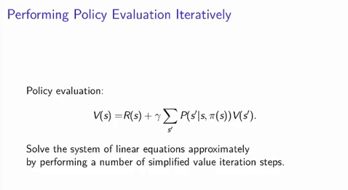
Policy Iteration

Slide 23

Policy Iteration
Policy Improvement
$$π_{i+1}\left(s\right)=argmax \sum{P\left(s^{′} | s,a\right) V^{πi}(si)}$$
Policy Iteration
$$V_{i}\left(s\right)=R\left(s\right)+γ∑P\left(s^{′} | s, π_{i}\left(s\right)\right)V_{i}(s^{′})$$

Slide 24
Thank You
Dr. Rajiv Misra, Professor
Dept. of Computer Science & Engg.
Indian Institute of Technology, Patna
rajivm@iitp.ac.in

